Slide 1
Location Choices for Chinese Hamburger Chain Stores in Sydney, Australia
IBM Data Science Course Capstone Project
Cheryl Wang

Slide 2
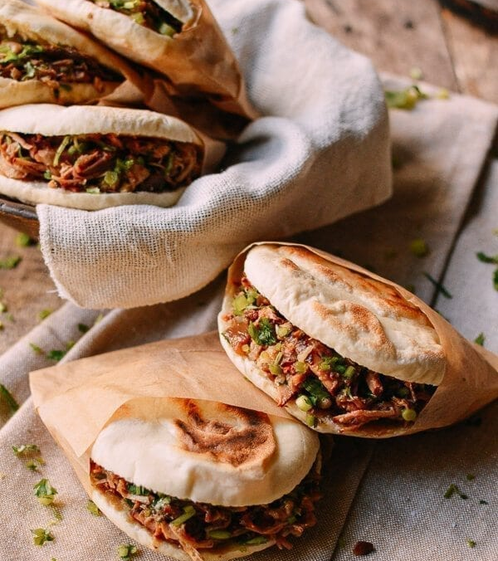
Business Case
Find a number of locations in Sydney, Australia for Chinese Hamburger restaurants.

Slide 3
The Data

Slide 4
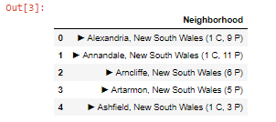
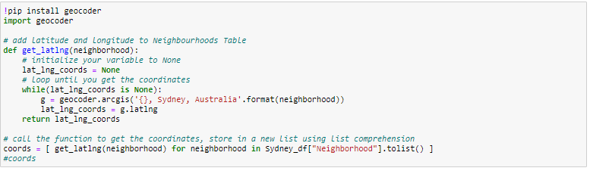
Methodology – Step 1 Map the Suburbs
Use Beautiful Soup for Web-scraping
Parsed into a Pandas Data Frame.
Use Geocoder to obtain the Latitude and Longitude
mapped the locations through folium

Slide 5
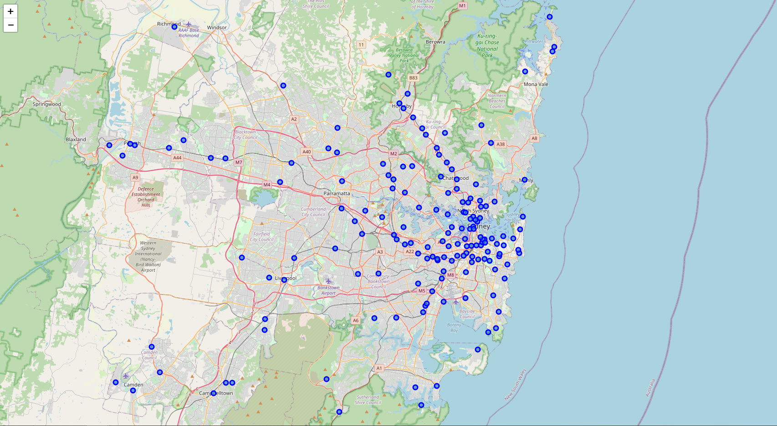
Methodology – Step 1 Map the Suburbs

Slide 6
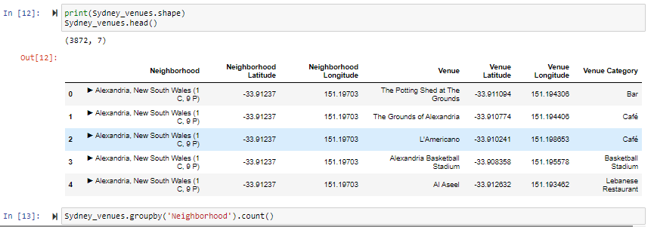
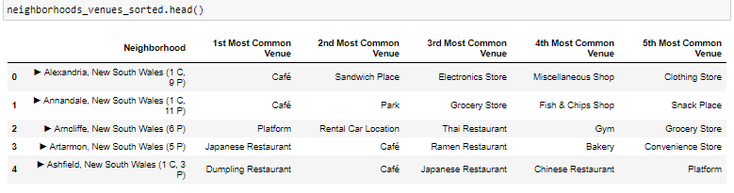
Methodology – Step 2 Explore the Suburbs
Use Foursquare API to explore the neighborhoods
List top 5 venues of each neighborhood

Slide 7
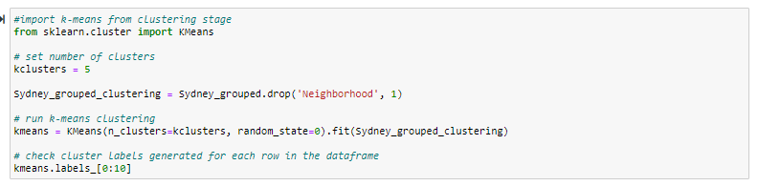
Methodology – Step 3 Cluster neighborhoods
Use K-means and grouped the 163 neighborhoods into 5 clusters
List top 5 venues of each neighborhood

Slide 8
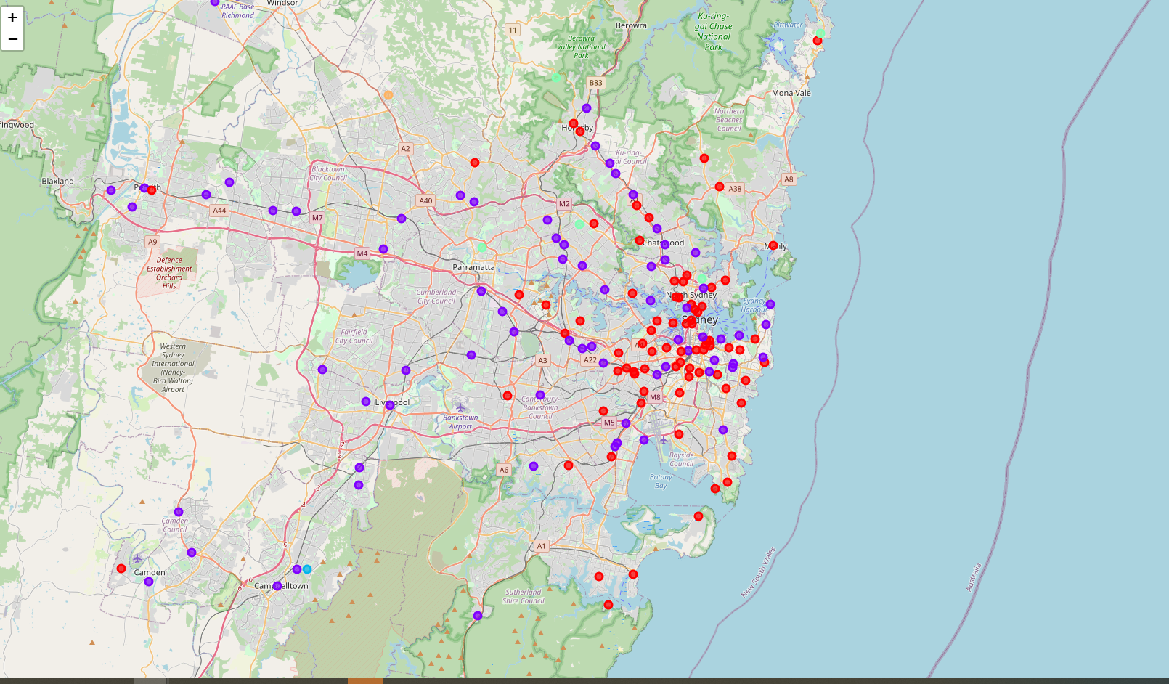
Methodology – Step 3 Cluster neighborhoods

Slide 9
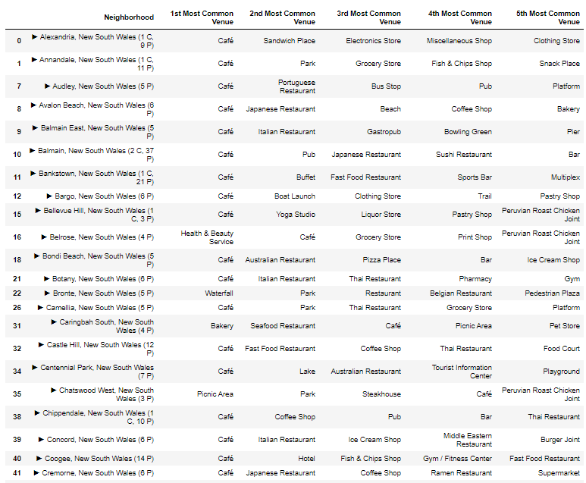
Results – Cluster 1
Cluster 1: 79 neighborhoods
Most common venue is Café

Slide 10
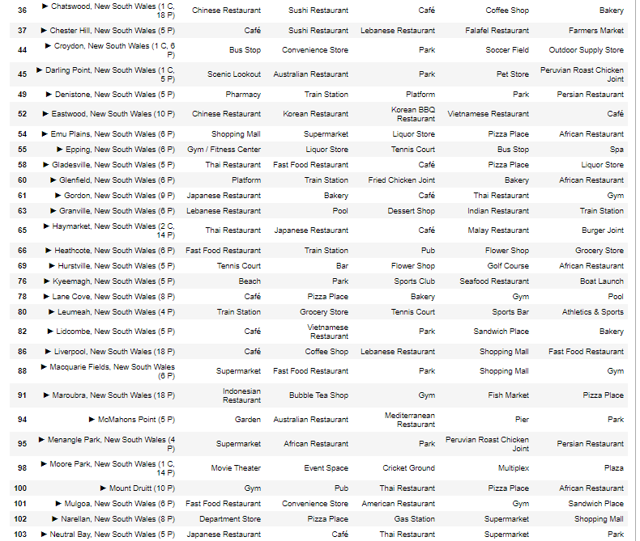
Results – Cluster 2
Cluster 2: 73 neighborhoods
has a variety of top venues
have food/drink as one of their top 5 venues

Slide 11
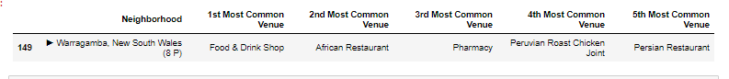
Results – Cluster 3
Cluster 3: 1 neighborhood
Most common venue is Food and Drink Shop

Slide 12
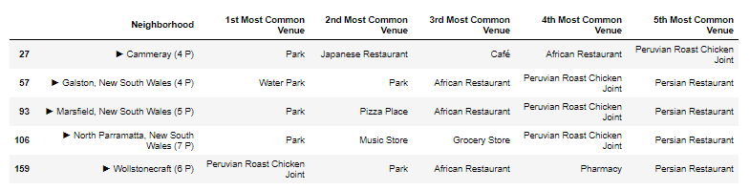
Results – Cluster 4
Cluster 4: 5 neighborhoods
Most common venue is Park

Slide 13
Results – Cluster 5
Cluster 5: 1 neighborhood
Most common venue is bus stop

Slide 14
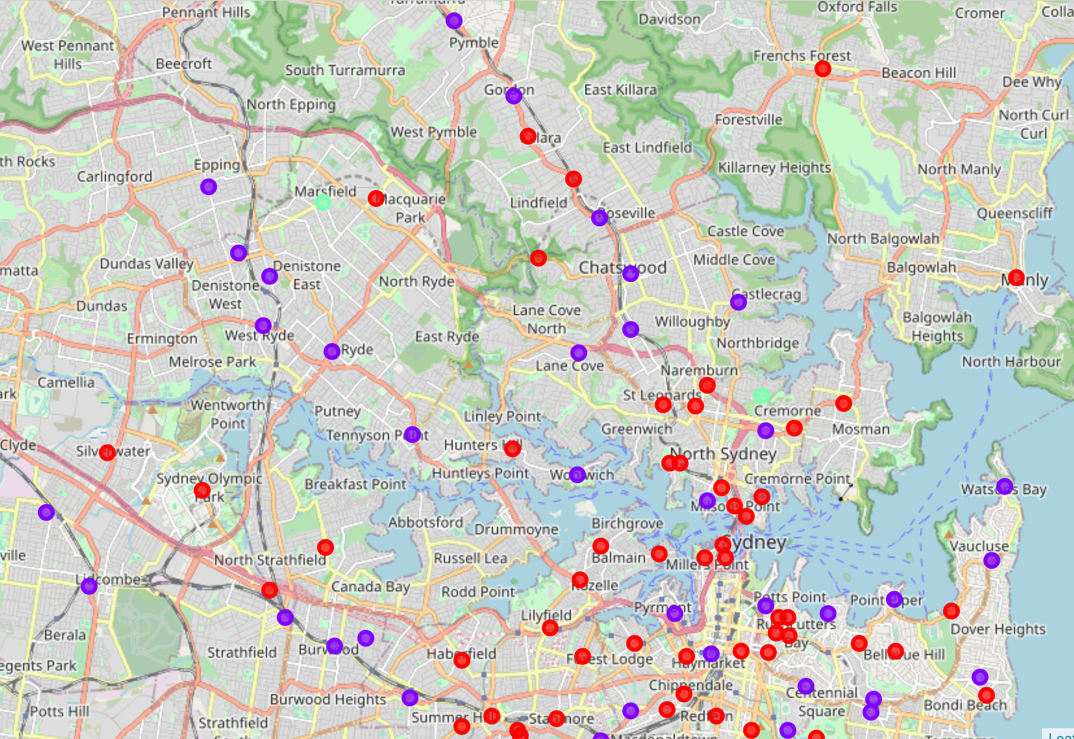
Recommendations
Neighborhoods in cluster No. 2 (purple dots)
Along the railway
Various venue for leisure and with options for a meal.
Has restaurants from all cultures but not focusing on a specific one.
Multi-cultural

Slide 15
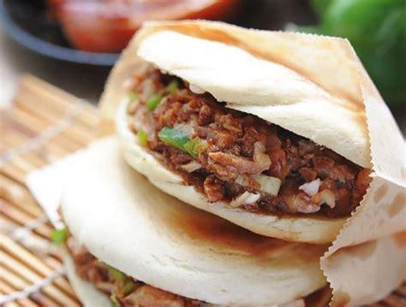
Discussions
Future improvement:
Limit venue selections to food related items only
Understand the correlation between venue categories and clustering
Understand why some venues are singled out (e.g. bus stop, food and drink shop)
Optimize the number of clusters

Slide 16
Conclusion
Python for Data Science is POWERFUL!
Matlab was my favorite programming tool 20 years ago, and its descendent does not disappoint me ☺

